Slide 1
Defining the Landscape of HLA Risk Alleles in Primary Nephrotic Syndrome and Post Kidney Transplant Recurrence 1U01AI152585-01
Rasheed Gbadegesin, MBBS, MD
Annette Jackson, PhD
4/28/2021

Slide 2
Disclosure
We have no conflict of interest associated with this talk

Slide 3

BACKGROUND
Childhood nephrotic syndrome (NS) is a rare immune-mediated kidney disease
Prevalence:16/100,000 children
NS classification: Initial response to corticosteroid RX
Steroid sensitive nephrotic syndrome (SSNS 80% ~MCD)
Steroid resistant nephrotic syndrome (SRNS 20% ~FSGS)
SRNS major cause of CKD/ESKD (Cost/year $120B)
Available treatment unsatisfactory
Recurrence post transplant major cause of kidney allograft failure

Slide 4
BACKGROUND
Pathogenesis not completely known
Evidence converge on common theme of T and B lymphocytes dysregulation
Alterations in T lymphocyte subsets during relapse of NS
Induction of remission by infections that can suppress T lymphocytes
Therapeutic agents used in RX are modulators of T cell function
B cells: B cell depletion with rituximab (monoclonal antibody against CD20 on B lymphocytes) can induce NS remission
HLA is essential in facilitating T and B lymphocyte interactions and may be an important mechanistic link in the pathogenesis of NS
Recent GWAS identified variants in HLA genes as risk loci for NS

Slide 5
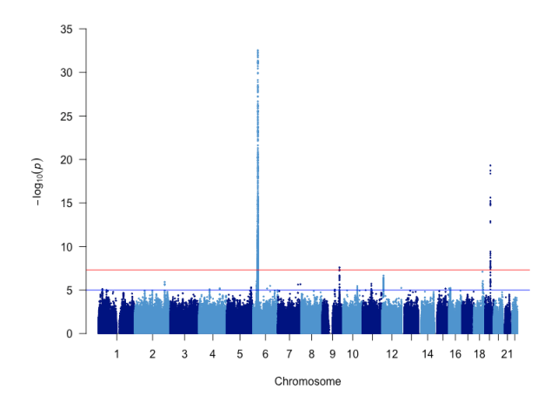
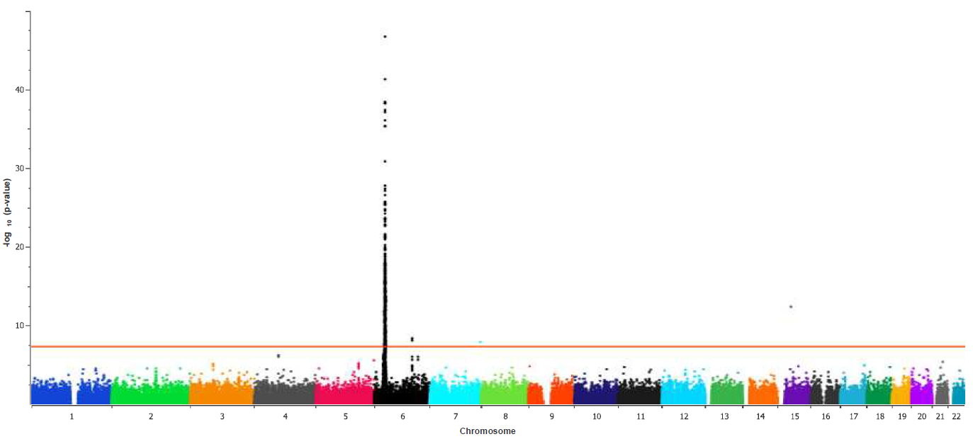
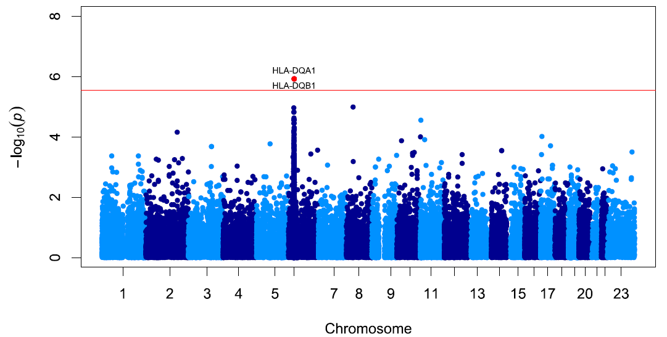
BACKGROUND
GWAS findings emphasize the role of adaptive immunity in the pathogenesis of SSNS
Gbadegesin et al JASN 2015
Population: South Asian, N: 214
Loci: HLA-DQA1, HLA-DQB1
Dufek et al JASN 2019
Population: European, N: 422
Loci: HLA-DR/DQ, CALHM6
Jia et al KI 2020
Population: Japanese, N: 987
Loci: HLA-DR/DQ, NPHS1-KIRREL2, TNFS15

Slide 6
BACKGROUND
Limitations of current GWAS studies
GWAS chips unable to infer precise allelic association because of high levels of polymorphism, gene duplications, and high levels of LD in HLA region
Use of small mono-ethnic cohorts in the majority of studies
Exclusion of children with SRNS
The HLA loci identified account for a very small % of the disease phenotype: there are other disease loci in and outside of the HLA genes yet to be identified
Deep NGS sequencing of all 11 HLA genes in a multiethnic cohort will identify new haplotypes and determine shared regulatory motifs that provide insight to molecular mechanisms.

Slide 7
BACKGROUND
Incomplete coverage of the HLA regions by GWAS preclude understanding of overlap between 1⁰ & 2⁰ NS
Defining the HLA risk overlap may lead to ID of unified pathways important in the pathogenesis of 1⁰ & 2⁰ NS
Unclear if haplotype driven HLA expression in immune cells and kidney underlies disease mechanisms
The role of NS HLA alleles/haplotypes in NS recurrence following kidney transplantation unknown

Slide 8
PROJECT GOALS
Broad hypothesis: Certain HLA alleles/haplotypes associated with NS can predict pattern of corticosteroid response in NS and risk of disease recurrence following kidney transplantation

Slide 9
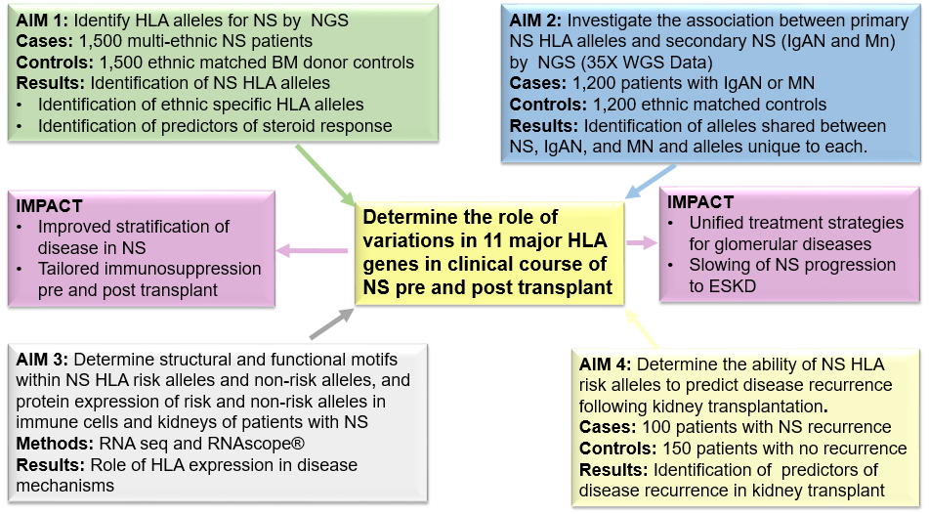
PROJECT GOALS

Slide 10
RESULTS AND PROGRESS REPORT
Regulatories
IRB approval Duke as a center
IRB approval Duke as a coordinating center
IRB approval from at least 5 collaborators
Case record forms (CRF)
CRF for all studies created and validated

Slide 11
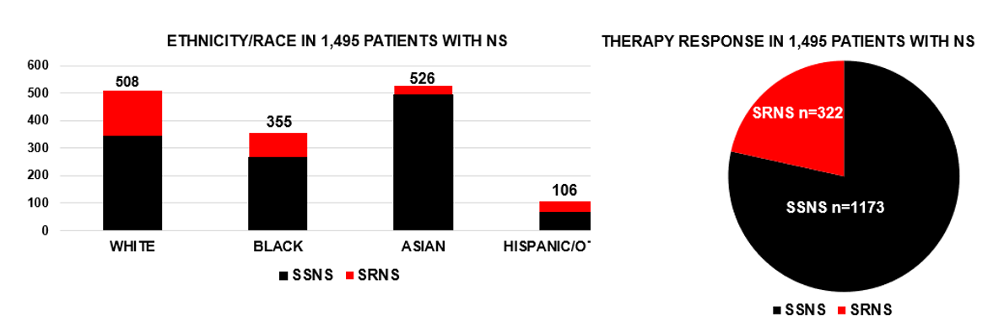
RESULTS AND PROGRESS REPORT
Phenotyping of 1,495 cases with NS (Target enrollment 1,500)

Slide 12
Preliminary report: Genotyping multiethnic megachip Alex Ochoa, PhD

Slide 13
RESULTS AND PROGRESS REPORT
Genotyping 1500 multiethnic patients with NS, >1,000 controls
Multiethnic megachips: >1.7 million SNPs
TOPMed Imputation Server
Binary traits: NS vs controls, SSNS vs SRNS
Association models for multiethnic (structured) populations:
HapQTL for haplotype association, Mixed-effect models (GCTA, GMMAT, SAIGE), LIGERA (developed by Dr. Ochoa)
Condition on known variants, local ancestry
Evaluate test statistic inflation, power, in simulations

Slide 14
RESULTS AND PROGRESS REPORT
Annotations:
NCBI and ensemble genome browsers
Regulatory regions: ENCODE, RoadMap Epigenomics
Ancestry:
Sub analysis: Single-ancestry tests, for identifying weaker ancestry-specific effects
Global ancestry estimation with ALStructure
Efficient Local Ancestry Inference (ELAI)

Slide 15
RESULTS AND PROGRESS REPORT
Preliminary analysis: 1,378 individuals (~1/2 of final)
879 cases (SSNS + SRNS)
469 controls
Not imputed (first pass)
Potential issues
~2:1 (case: control) overall imbalance
Imbalances vary by ancestry
28:1 for Hispanics
1:3 for East Asians

Slide 16
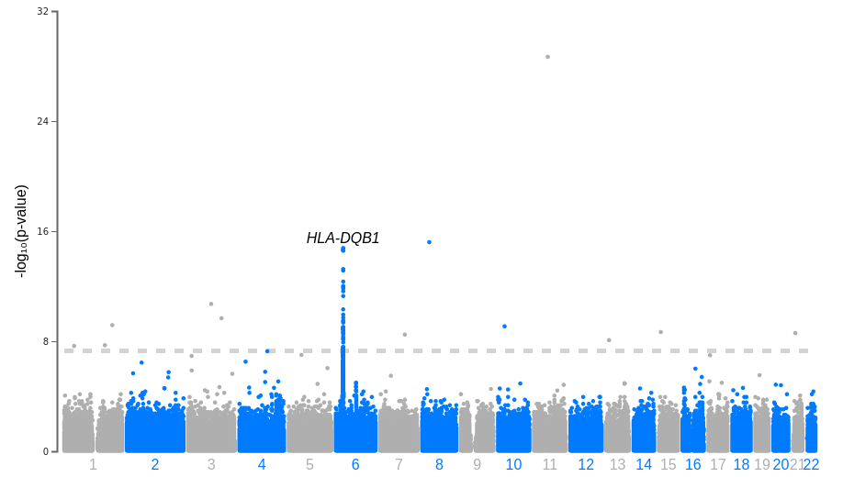
RESULTS AND PROGRESS REPORT
HLA locus has clear association signal!!
Other very significant loci are novel, appear robust (significant for various methods).

Slide 17
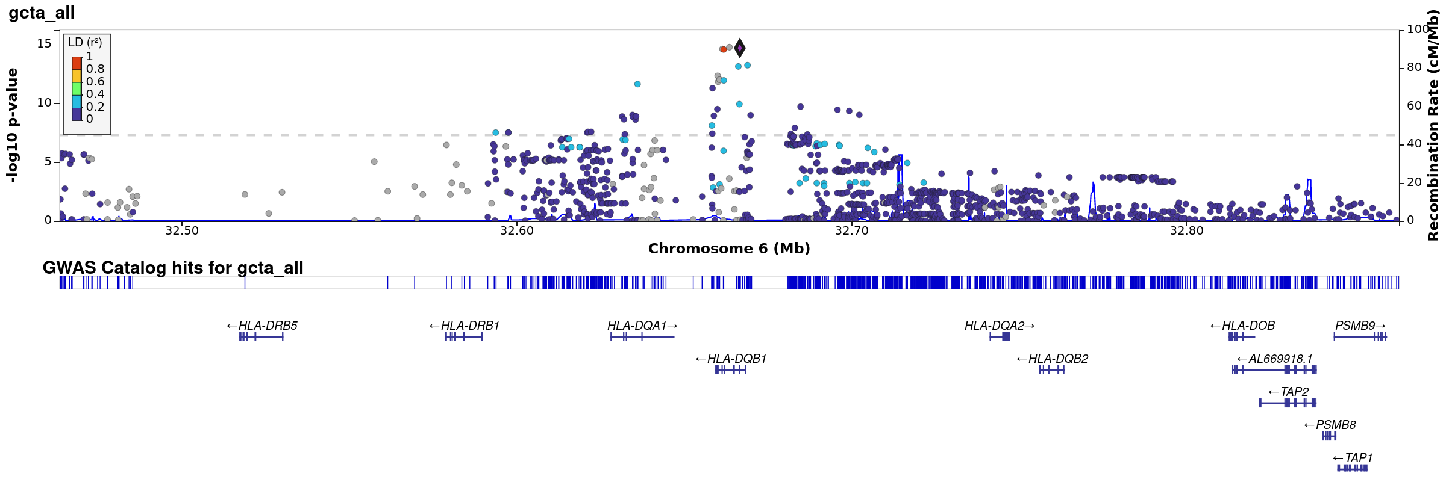
RESULTS AND PROGRESS REPORT

Slide 18
Preliminary report: HLA NGS sequencing Annette Jackson, PhD
Cliburn Chan, MBBS, PhD

Slide 19
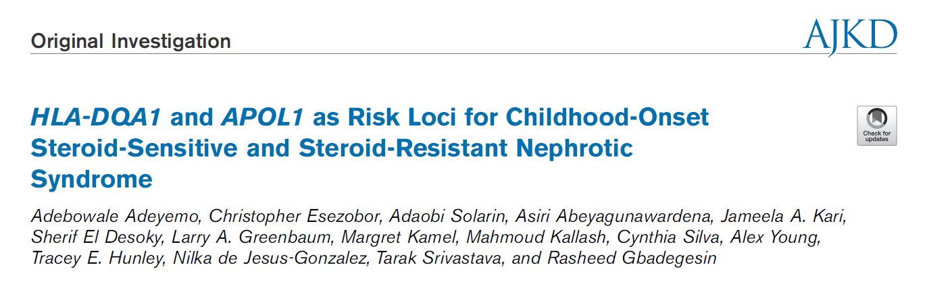
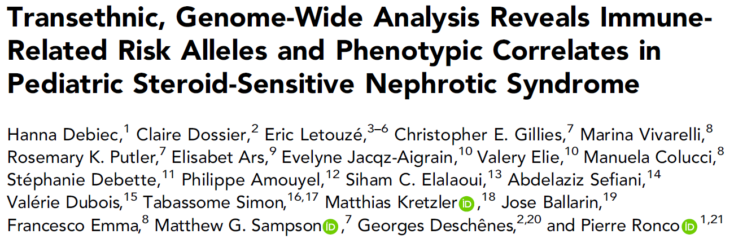
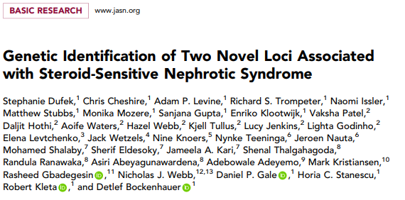
RESULTS AND PROGRESS REPORT
Preliminary NGS HLA SEQUENCING
43 patients with NS: 27 SSNS, 16 SRNS
Black (44.15%), White (44.15%), Asian (7.0%), Hispanic (4.7%)
Determine frequency of DR7-DQ2 (risk) and DR13-DQ6 (protective) previously associated with SSNS

Slide 20
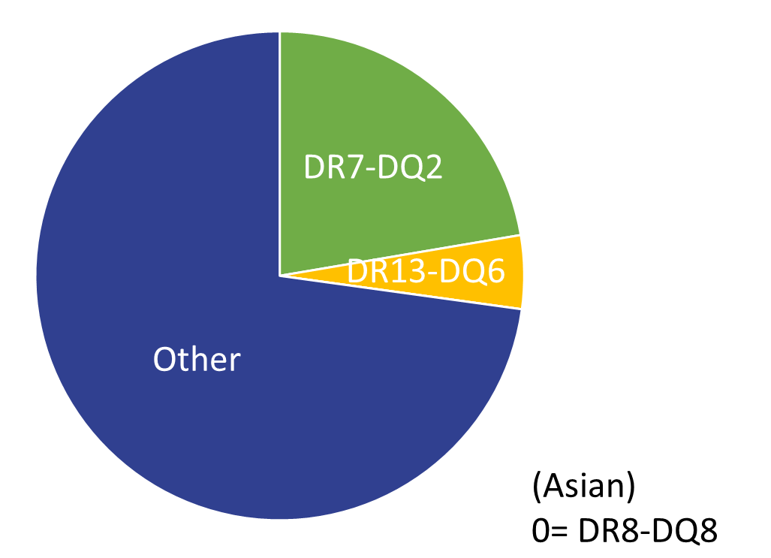
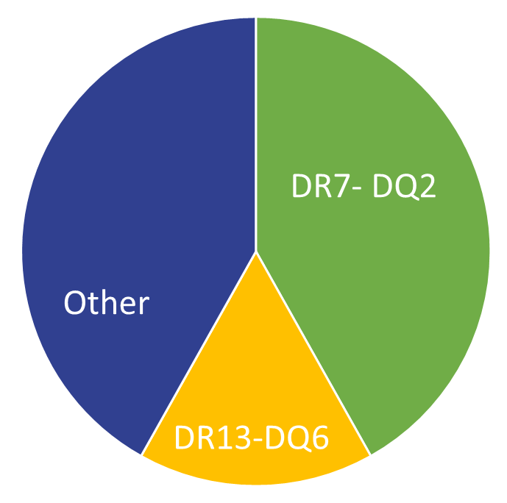
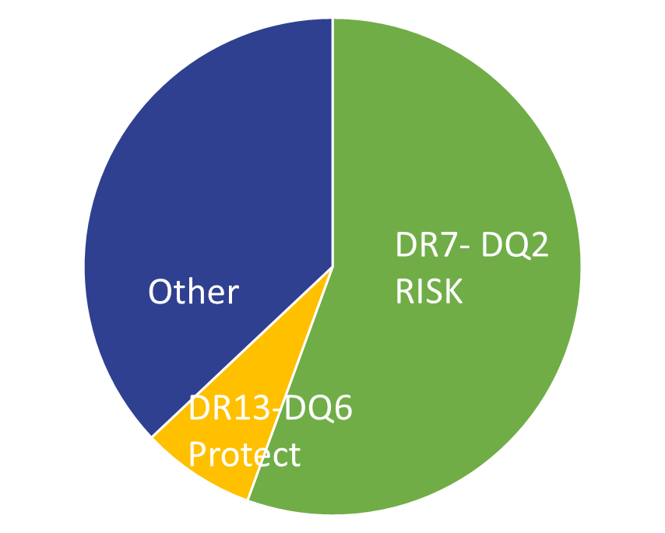
RESULTS AND PROGRESS REPORT
HLA NGS SEQUENCING NS (NATIVE KIDNEY)
NORMAL POPULATION
43 PATIENTS WITH NS
27 PATIENTS WITH SSNS

Slide 21
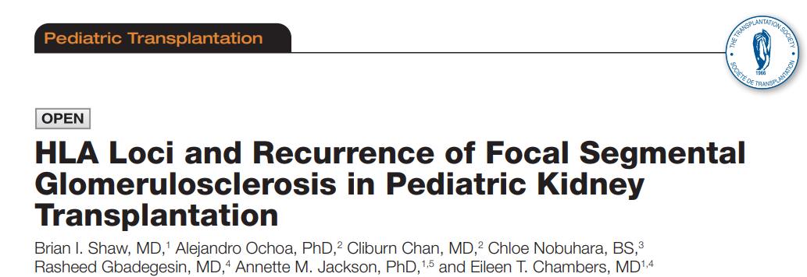
RESULTS AND PROGRESS REPORT
HLA Haplotype and risk of NS recurrence following kidney transplantation
Retrospective review: SRTR Transplant Registry
> 334,947 Kidney Transplants after 2000 (HLA DNA typing)
Study cohort: 1,196 pts with diagnosis of FSGS/SRNS, and 6 months FUP
Univariate logistic regression: association of an HLA antigen (A, B, C, DR51, DR52, DR53, DR, and DQ) with disease recurrence using likelihood ratio tests

Slide 22
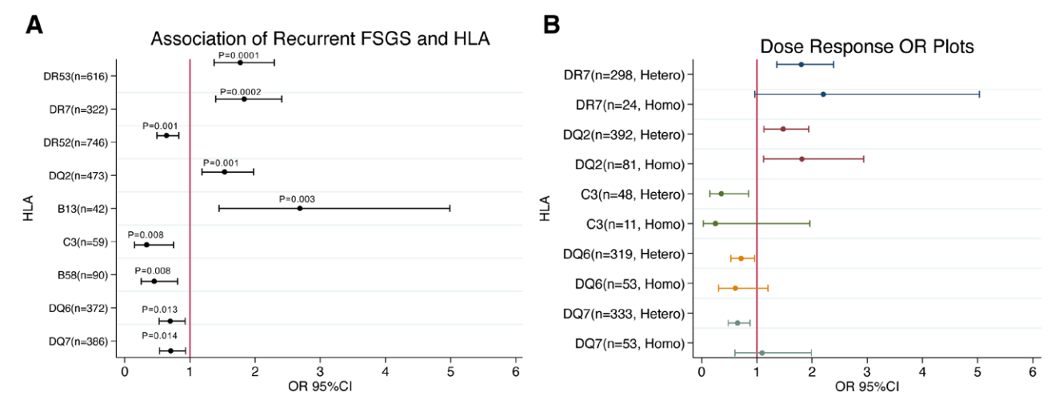
RESULTS AND PROGRESS REPORT
Multivariate Models: DR7-DR53-DQ2 Risk Haplotype (OR 1.7)
No increased Risk, Kidney Donor= DR7-DR53-DQ2

Slide 23
KEY ISSUES, CHALLENGES, AND SOLUTION
Enrollment for Aim 4 slow
Challenging enrolling steroid naïve patients
Solutions
Engaging more collaborators
Single cell sequencing of B and T cells from paired samples may be a viable alternative for determining HLA gene expression during relapse and remission

Slide 24
MOVING FORWARD
Definitive analysis of genotyping data
Continue NGS of HLA genes
Retrieve data for Aim 2 from collaborating consortium for pan glomerular disease analysis (NS, IgA, membranous)
Ramp up enrollment for studies in Aims 3 and 4

Slide 25
Other proposed analyses in Years 3-5
Aim 3
Is there differential expression of risk and non-risk alleles?
If so, what determines differential expression?
Aim 4
Can we predict disease recurrence following kidney transplantation?

Slide 26
SHARED RESOURCES/FEEDBACK
Well defined control cohorts >2,000 with genotyping using multi ancestry genotyping chip

Slide 27
GENOMICS OF NS TEAM: DUKE
PEDIATRICS
Rasheed Gbadegesin
Eileen Chambers
Megan Chryst-Stangl
SURGERY AND IMMUNOLOGY
Annette Jackson
Ashley Drabik
Brian Shaw
BIOSTATISTICS AND STATISTICAL GENETICS
Cliburn Chan
Alex Ochoa
Amika Sood
Tiffany Tu
COLLABORATORS
Debo Adeyemo NHGRI
NMDP Consortium
PNRC

